Slide 1
Lesson 6
Review + Final Project

Slide 2
Agenda
Review
Best Practices
Tips
Project
Time to create!

Slide 3
Common HTML Tags
Common tags: <div>, <span>, <header>, <footer>, <nav>, <section>, <article>, <p>, <h1> - <h6>, <a>, <img>, <ul>, <li>, <form>, <input>, etc.
Lists, input, text formatting
Semantic HTML
Attributes: class, id, src, href, alt, title, style, etc.
Images, Links

Slide 4
Common CSS Properties and Selectors
Properties: color, background-color, font-size, margin, padding, border, width, height, display, position, float, clear, etc.
Selectors: element selectors, class selectors, id selectors, descendant selectors, pseudo-classes, pseudo-elements.

Slide 5
Important Concepts
Block and Inline elements
Inline, internal and external CSS
The CSS Hierarchy
Box Model
Flexbox
Media Queries
Pseudo-classes (e.g. for <a>)
Pseudo-elements
Transitions & Animations

Slide 6
Best Practices

Slide 7
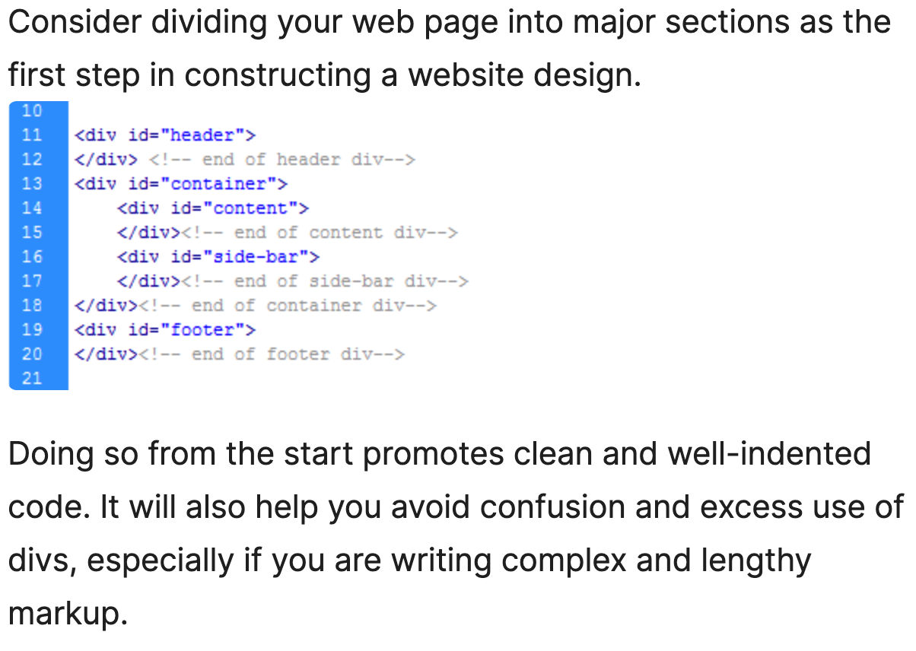
Use Divs to Divide Layouts into Major Sections
Separate Content from Presentation
Try to go for external CSS usually
Try not to avoid internal/inline

Slide 8
Group Similar Elements
Separate Content from Presentation
For example, in CSS, if you are styling some headings and you want to have an animation for them or something else, keep all of the heading-related selectors together
Try to go for external CSS usually
Try not to avoid internal/inline

Slide 9
Group Similar Elements
Separate Content from Presentation
Group related styles together.
Use comments to separate different sections of the stylesheet.
Follow a consistent naming convention for classes and IDs.
Try to go for external CSS usually
Try not to avoid internal/inline

Slide 10
Writing Clean and Semantic HTML
Separate Content from Presentation
Use appropriate tags for content: <header>, <footer>, <nav>, <article>, <section>.
Ensure HTML is well-structured and easy to read.
Maintain consistent spacing, font sizes, and colors across the site.
Use a limited color palette and stick to it. (try www.coolors.co)
Ensure that the site's design is cohesive.

Slide 11
Tips

Slide 12
Basic Principles
Alignment: Ensure elements are properly aligned.
Proximity: Group related items together.
Contrast: Use contrasting colors to make important elements stand out.
Repetition: Repeat design elements to create a cohesive look.
Navigation: Make your site fluid and easy to navigate.

Slide 13
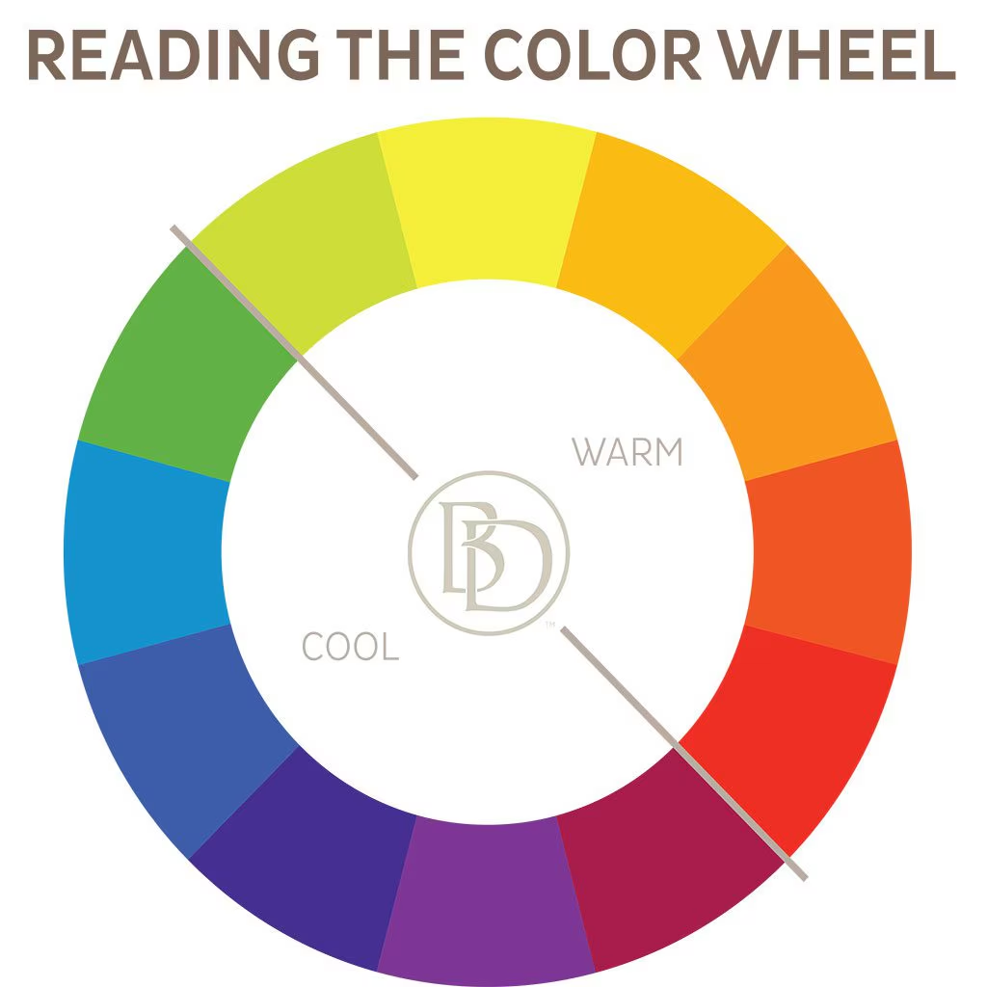
Color Theory:
See what looks best for your site.
Complementary Colors: Colors opposite each other on the color wheel.
Analogous Colors: Colors next to each other on the color wheel.

Slide 14
Typography
Choosing Fonts: Select fonts that are easy to read and match the site's theme.
Font Pairing: Use a maximum of two or three different fonts that complement each other.
Readability: Ensure text is easy to read with appropriate font size, line height, and contrast.
https://fonts.google.com/

Slide 15
Project

Slide 16
Personal Website
If you don’t want to create a personal website, you can try a website explaining a topic or a website about another person/character.
Instructions Navbar
Wireframing, Examples
Wireframe on paper or on Figma

Slide 17
Thanks & Happy Hacking!

